Slide 1

Introduction into fMRI analysis. PsyMsc4 (Goethe 2021).
Session-4
Javier Ortiz-Tudela and Francesco Pupillo

Slide 2
Recap of last week
General recap.
Beta estimates cannot be interpreted directly.
T and F contrasts can be used to compare conditions.
Beware of contrasts against implicit baseline.
Contrast vectors are widely used and powerful.
When designing an experiment, always chose an appropriate baseline.
1 -1 0

Slide 3
Functional MRI. Group-level analysis.
We have obtained contrast maps for each participant in our study. These contrast maps contain the values for each participant that correspond to our contrast vectors. Namely, the differences between conditions (in the directions specified by the vectors).
Similarly as for a behavioral study, now we would want to see how consistent are those differences across the entire sample.
1 -1 0

Slide 4
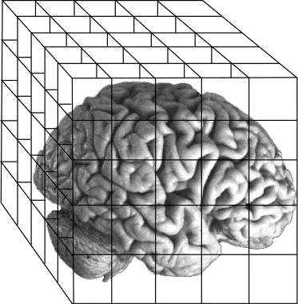
Functional MRI. Group-level analysis.
What are group-level analysis?
Comparison with a (rather) equivalent process to understand the rationale of the steps that we have done.
Behavioral
fMRI
Trials
Runs
Subjects
(...)
(...)
Subjects
(...)
(...)
Group
Group

Slide 5
Functional MRI. Group-level analysis.
What are group-level analysis?
Comparison with a (rather) equivalent process to understand the rationale.
Behavioral
fMRI
Trials
Runs
mean()
glm()
Subjects
(...)
(...)
T test()
Subjects
(...)
(...)
T test()
Group
Group

Slide 6
Functional MRI. Group-level analysis.
Different names for the same (conceptual) steps on different packages.
 | FSL | SPM
Subjects | 1st level | 1st level
Runs | 2nd level
Group | 3rd level | 2nd level

Slide 7
Functional MRI. Group-level analysis.
So how do we do this? Back to RTs...
Participants / Conditions | Congruent | Incongruent | Congruituy effect
1 | 750 | 889 | 139
2 | 322 | 569 | 247
3 | 477 | 789 | 312
4 | 566 | 865 | 299
(...) | (...) | (...) | (...)
We can take these values and run T test against zero.
We will get a T value.
QUESTION:
What will this test tell us?

Slide 8
Functional MRI. Group-level analysis.
What if we do this in one voxel?
Participants / Conditions | Congruent | Incongruent | Congruituy effect
1 | 1750 | 889 | -861
2 | 2322 | 1569 | -753
3 | -477 | -789 | -312
4 | 638 | -1556 | -2194
(...) | (...) | (...) | (...)
We can take these values and run T test against zero.
QUESTION:
What will this test tell us?

Slide 9
Functional MRI. Group-level analysis.
And if we run this in all the v
Voxels / Conditions | Congruent | Incongruent | Congruituy effect
1 | 1750 | 889 | -861
2 | 2322 | 1569 | -753
3 | -477 | -789 | -312
4 | 638 | -1556 | -2194
(...) | (...) | (...) | (...)
We can take these values and run T test against zero.
QUESTION:
What will this test tell us?

Slide 10
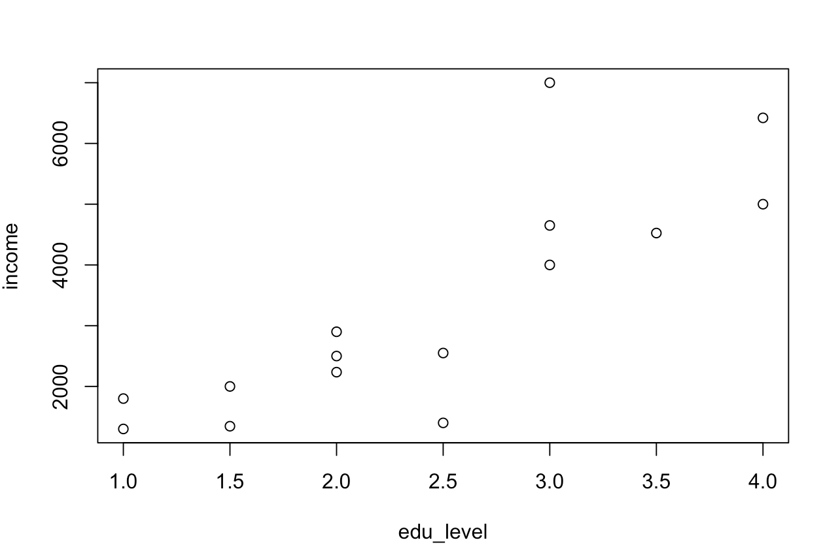
Functional MRI. Inference.
Our GLM (linear regression) outputs beta estimates for each one of our regressors.
However, we cannot draw inferences directly from betas. Why?
A “real life” example: Let’s predict income from education level.
Income in USD and education level from 1 (High school) to 4 (PhD)
beta = 1561.6

Slide 11
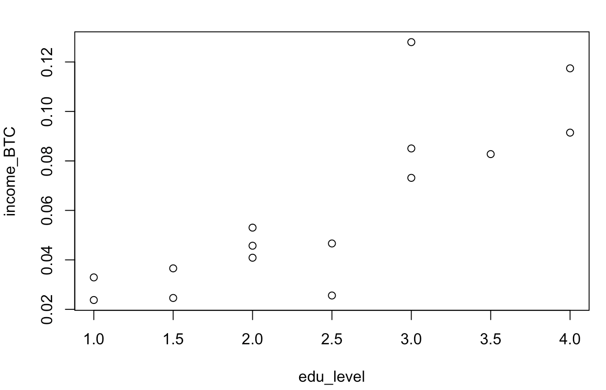
Functional MRI. Inference.
Our GLM (linear regression) outputs beta estimates for each one of our regressors.
However, we cannot draw inferences directly from betas. Why?
A “real life” example: Let’s predict income from education level.
Income in BTC and education level from 1 (High school) to 4 (PhD)
beta = 0.0286

Slide 12
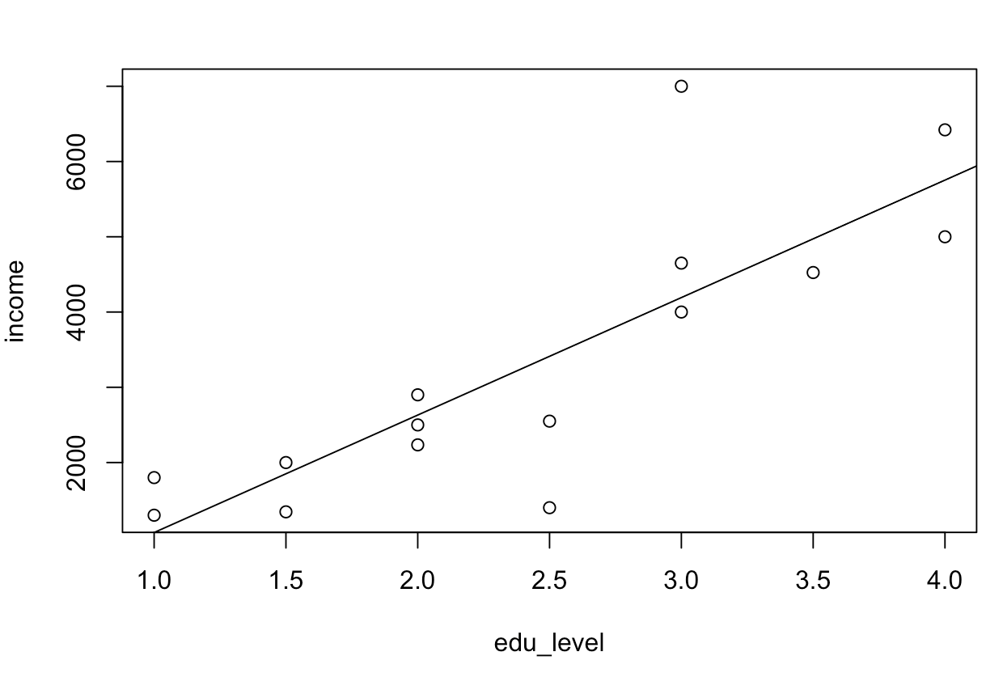
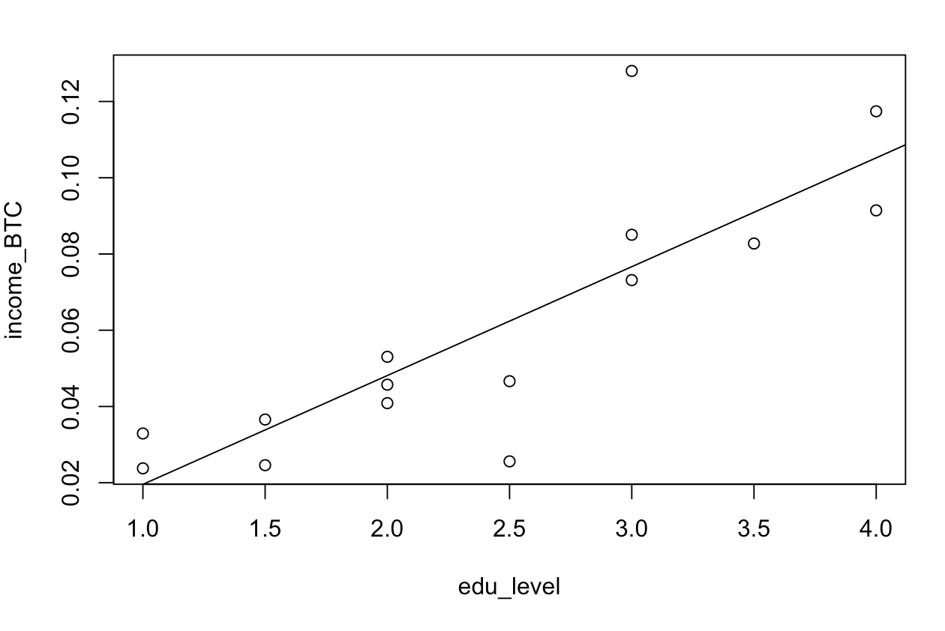
Functional MRI. Inference.
Our GLM (linear regression) outputs beta estimates for each one of our regressors.
However, we cannot draw inferences directly from betas. Why?
A “real life” example: Let’s predict income from education level.
Income in USD -> beta = 1561.6
Income in BTC -> beta = 0.0286

Slide 13
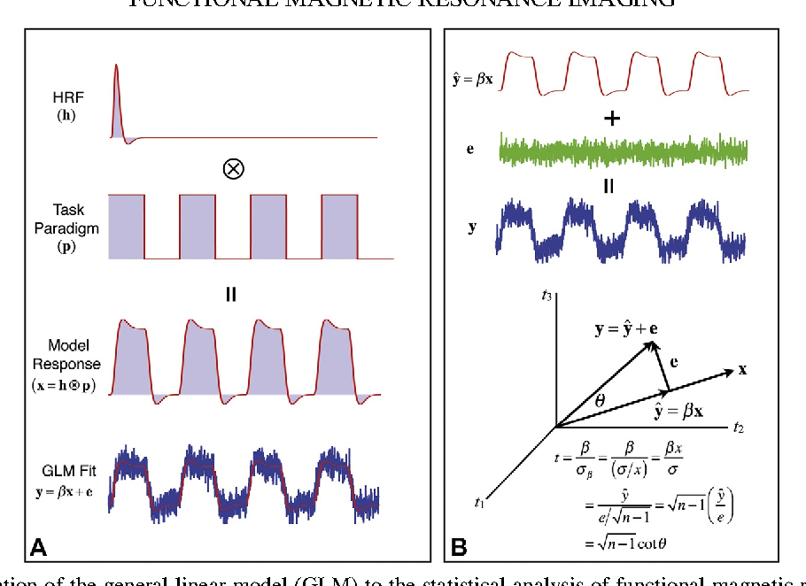


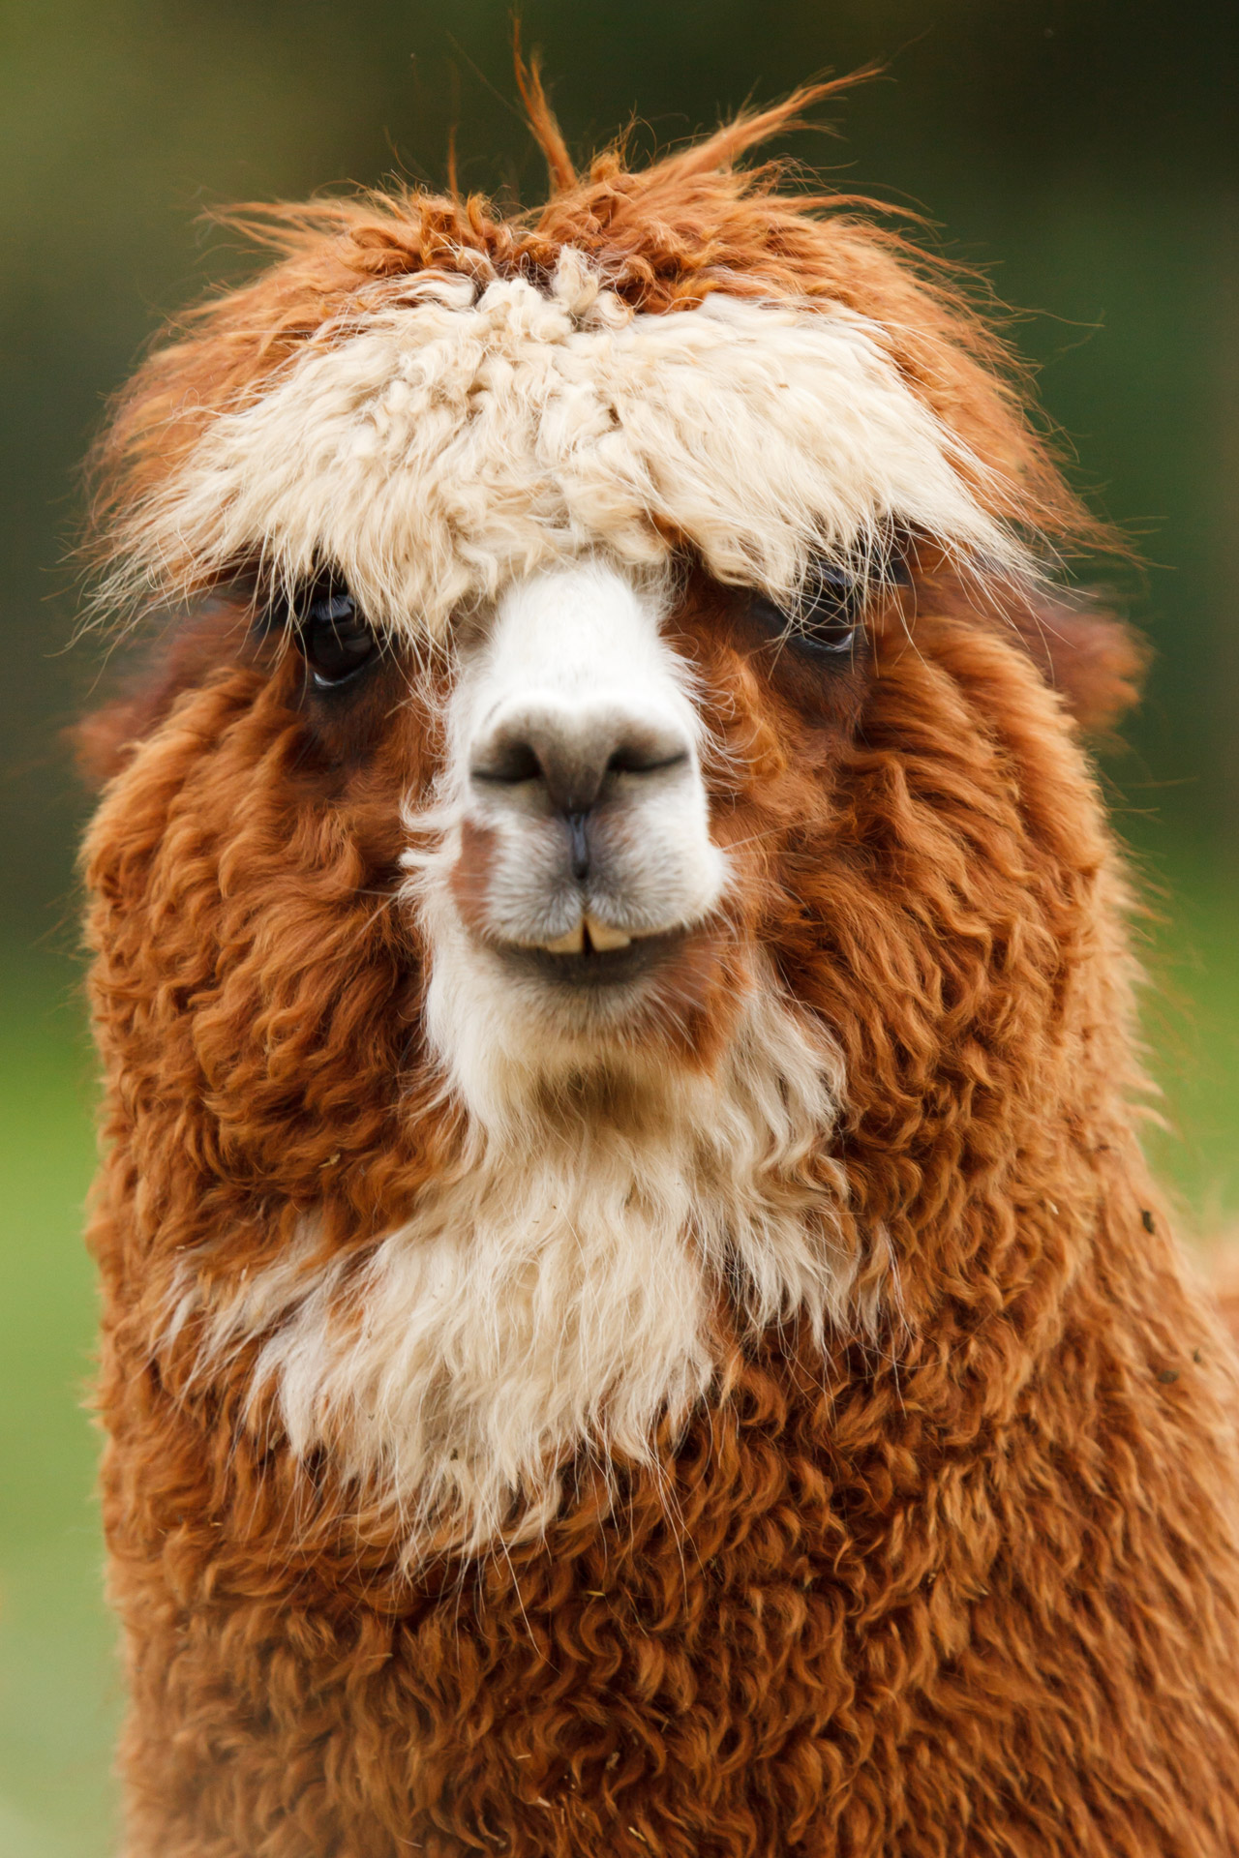
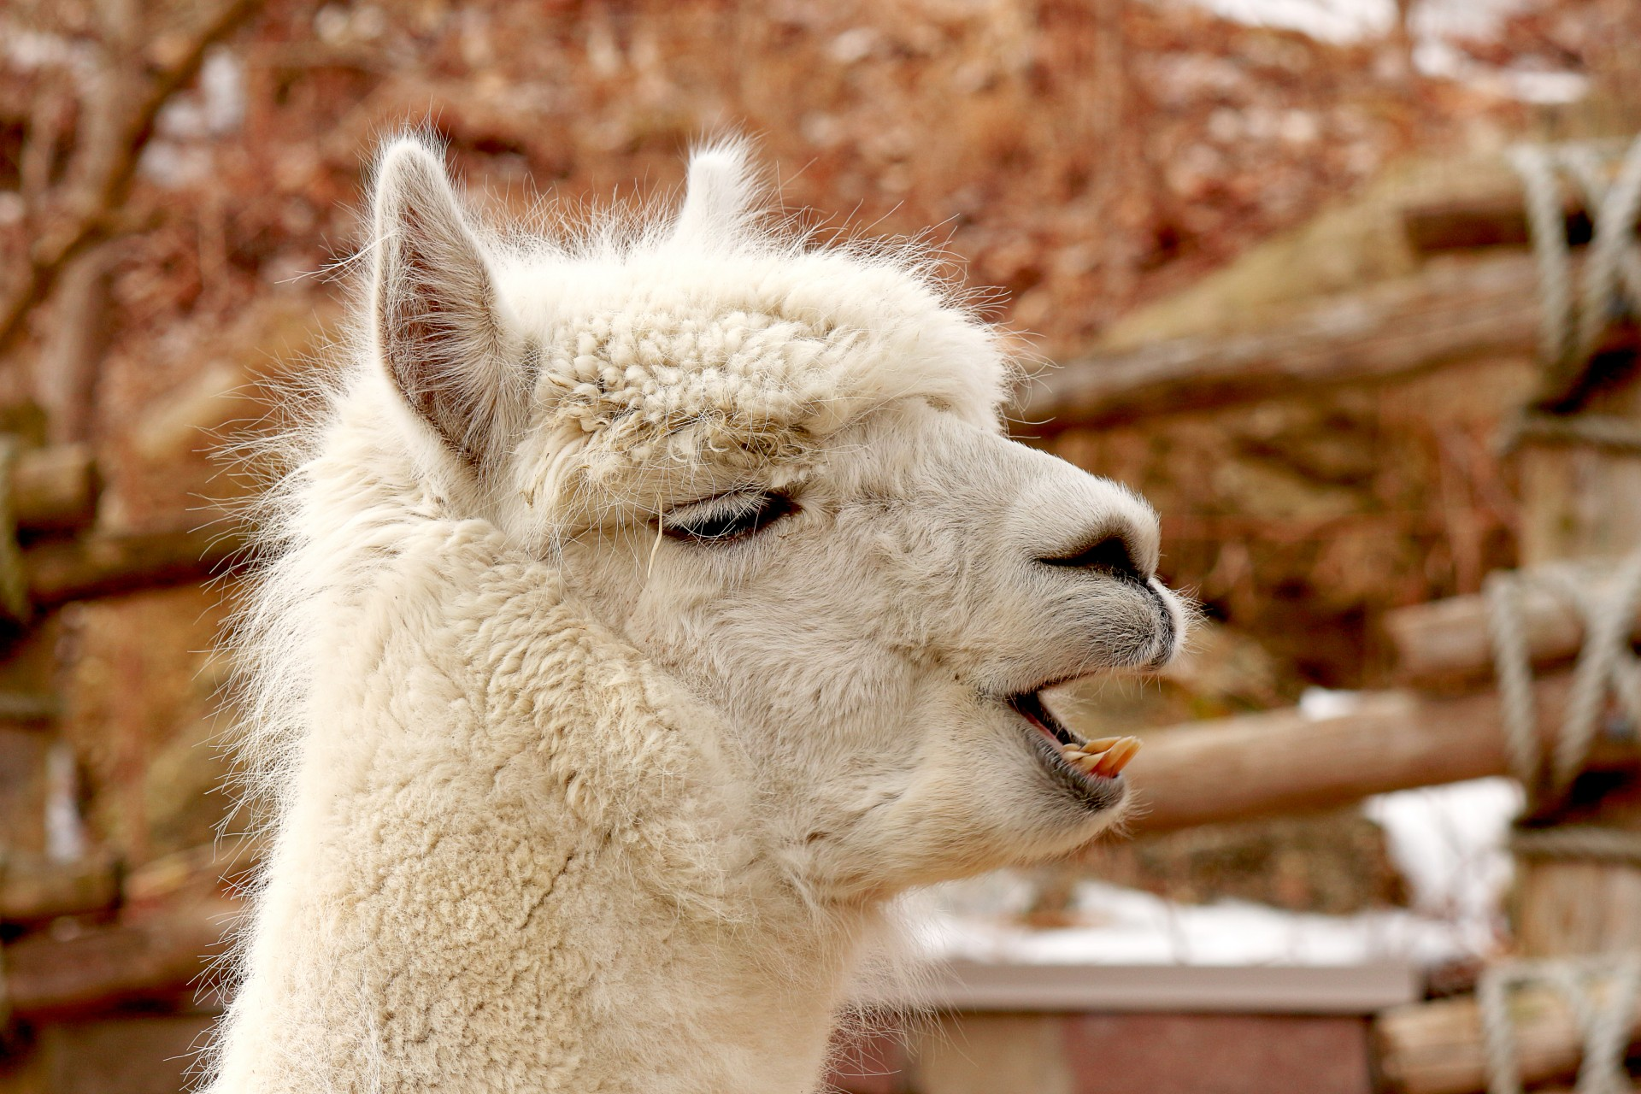
Functional MRI. Inference.
We need to convert them to something meaningful.
Enter the t-statistic!
Beta1
Beta2

Slide 14
Functional MRI. Inference.
A critical concept in fMRI research: contrast.
Different types of contrasts:
T-tests
Against baseline.
Between regressors.
F-tests
Beta1
Beta2

Slide 15
Functional MRI. Inference.
A critical concept in fMRI research: contrasts.
T-test against (implicit) baseline.
Beta1
Beta2

Slide 16
Functional MRI. Inference.
A critical concept in fMRI research: contrasts.
T-test against (implicit) baseline.
Enter contrast vectors.
Beta1
Beta2

Slide 17
Functional MRI. Inference.
A critical concept in fMRI research: contrasts.
T-test against (implicit) baseline.
Enter contrast vectors. A set of values (a.k.a., weights) representing the comparison that we want to make.
We can use them to select the betas that we will contrast by defining a weight for each beta.
With contrast vectors we can easily define:
Simple comparisons for multiple conditions.
Complex sets of comparisons across conditions.
They are used in most fMRI analysis packages.
Beta1
Beta2

Slide 18
Functional MRI. Inference.
A critical concept in fMRI research: contrasts.
T-test against (implicit) baseline.
Enter contrast vectors. A set of values (a.k.a., weights) representing the comparison that we want to make.
We can use them to select the betas that we will contrast by defining a weight for each beta.
Example: Let’s select only the beta for DOG FACES.
Contrast
vector
1
Beta1
0
Beta2

Slide 19
Functional MRI. Inference.
A critical concept in fMRI research: contrasts.
What if we want to have a finer question? Which voxels are more active for DOG FACES than for ALPACA FACES?
QUESTION:
How should we set the contrast vector?
Contrast
vector
Beta1
Beta2

Slide 20
Functional MRI. Inference.
A critical concept in fMRI research: contrasts.
What if we want to have a finer question? Which voxels are more active for DOG FACES than for ALPACA FACES?
Dogs > Alpacas
Contrast
vector
1
Beta1
-1
Beta2

Slide 21


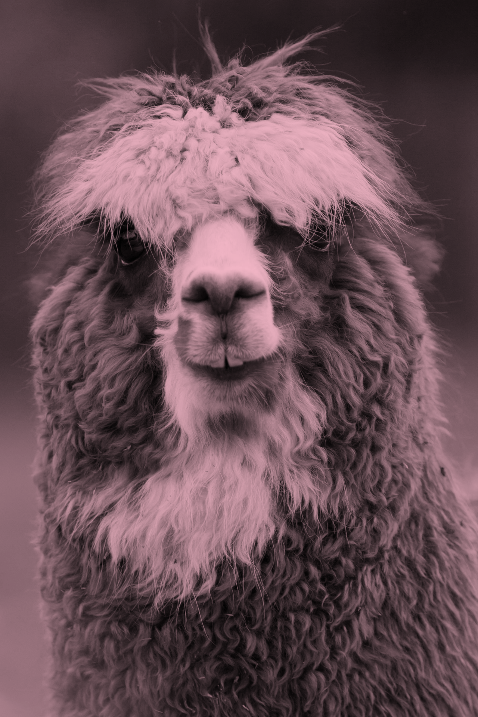
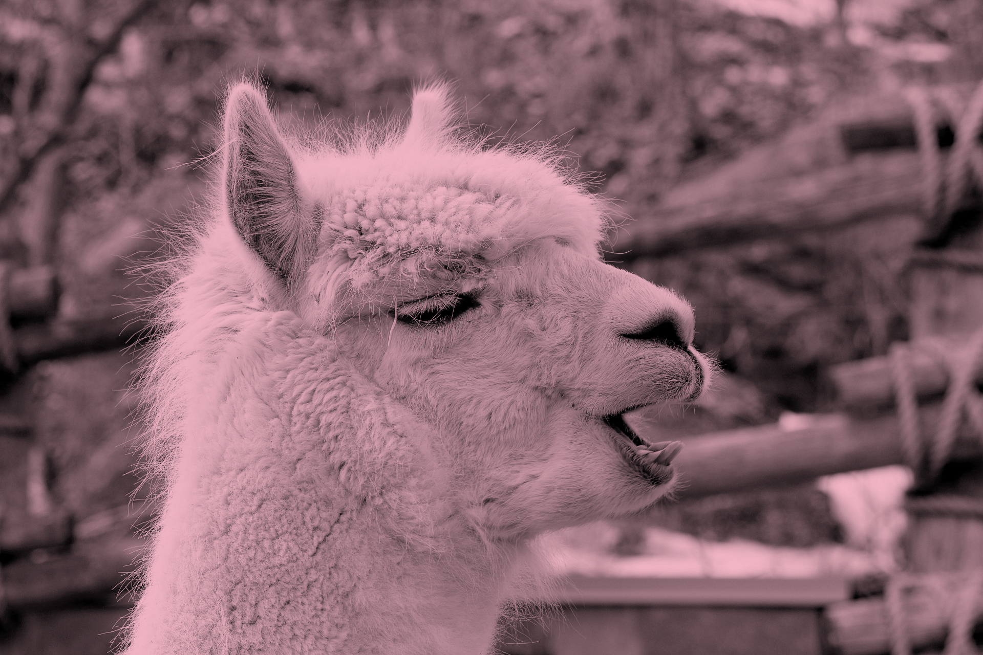
Functional MRI. Inference.
A critical concept in fMRI research: contrasts.
What if our question is more complex?
Does the brain response to staring differ between dog faces and alpaca faces?
F-tests

Slide 22
Functional MRI. Inference.
A critical concept in fMRI research: contrasts.
What if our question is more complex?
Does the brain response to staring differ between dog faces and alpaca faces?
F-tests
Beta1
Beta2
Beta3
Beta4
“One beta per trials is estimated”

Slide 23
Functional MRI. Inference.
A critical concept in fMRI research: contrasts.
What if our question is more complex?
Does the brain response to staring differ between dog faces and alpaca faces?
F-tests
Dogs > Alpacas
Staring > Side-ways
1
1
Beta1
1
-1
Beta2
-1
1
Beta3
-1
-1
Beta4
“One beta per trials is estimated”

Slide 24
Functional MRI. Inference.
IMPORTANT NOTE:
Your fMRI experiment is only as good as your baseline.
Can we find the love brain region?
Can we find brain areas related to political affiliation?
Can we find voxels for Jennifer Aniston?
Beta1
Beta2

Slide 25
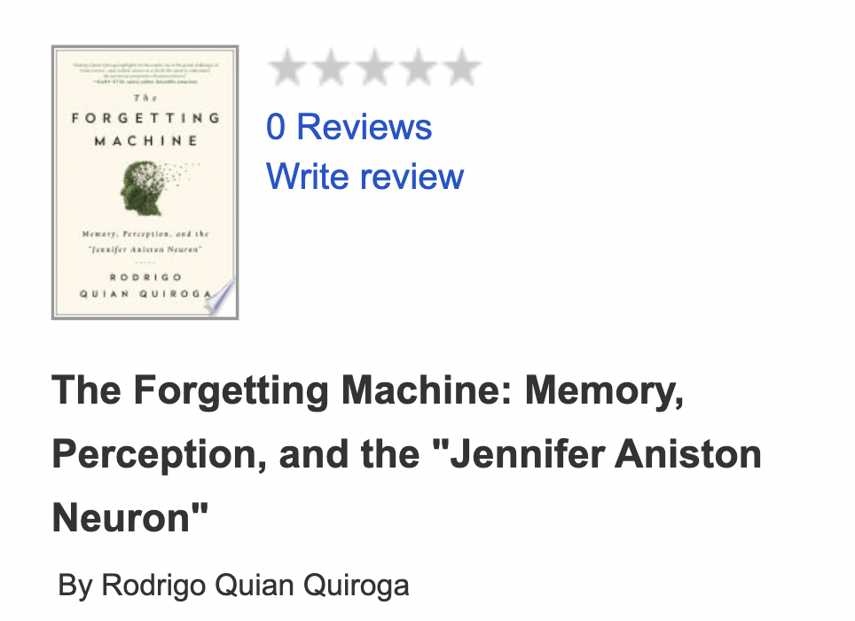
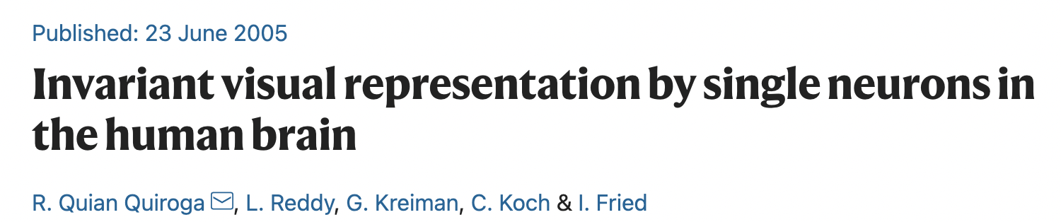
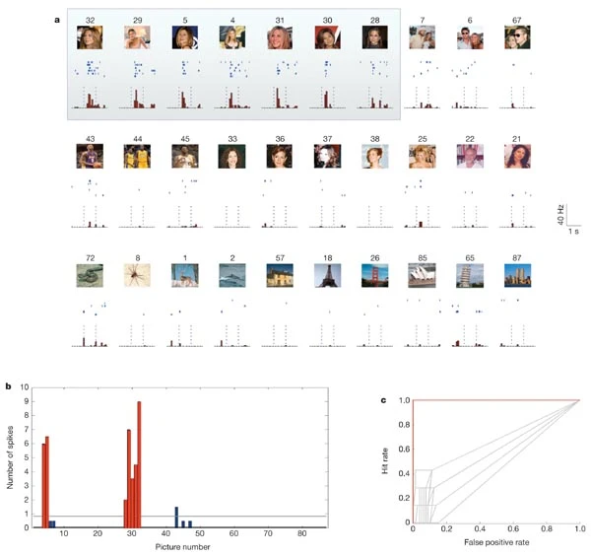
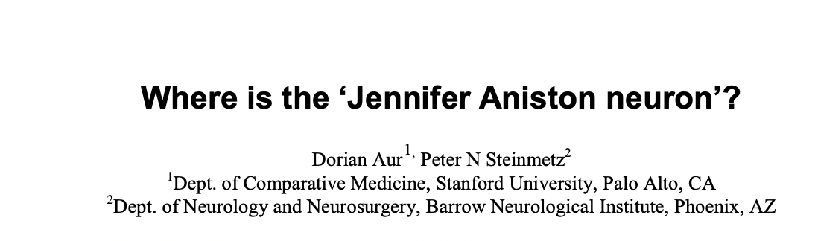
Functional MRI. Inference.
IMPORTANT NOTE:
Your fMRI experiment is only as good as your baseline.
Can we find the love brain region?
Can we find brain areas related to political affiliation?
Can we find voxels for Jennifer Aniston?
Beta1
Beta2

Slide 26
GLM
General recap.
Beta estimates cannot be interpreted directly.
T and F contrasts can be used to compare conditions.
Beware of contrasts against implicit baseline.
Contrast vectors are widely used and powerful.
When designing an experiment, always chose an appropriate baseline.
Beta1
Beta2

